Slide 1
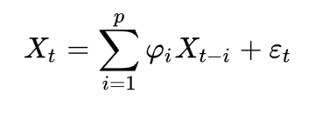
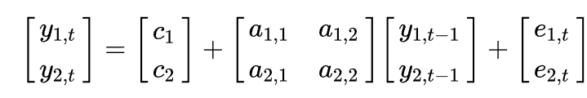

AR vs VAR
AR
VAR
Using statsmodels ARIMA model
Using statsmodels VARMAX model
https://www.statsmodels.org/stable/generated/statsmodels.tsa.arima.model.ARIMA.html#statsmodels.tsa.arima.model.ARIMA
https://www.statsmodels.org/stable/generated/statsmodels.tsa.statespace.varmax.VARMAX.html

Slide 2
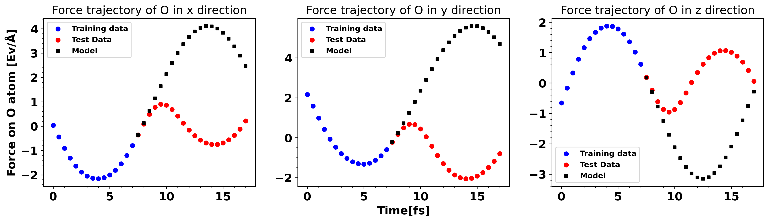
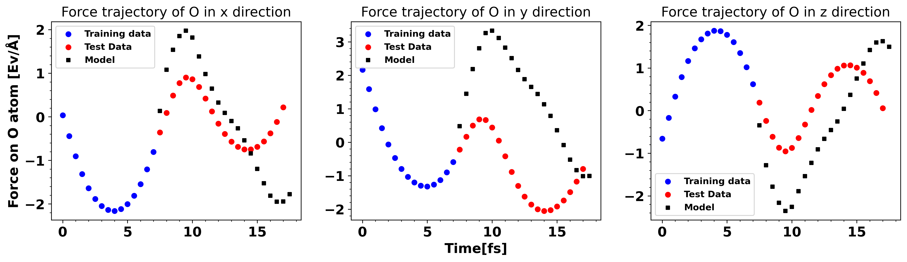
Type: AR
Input: 15
Pred: 20
Time: ~0.8s
Type: VAR on O
Input: 15
Pred: 20
Time: ~2.8s

Slide 3
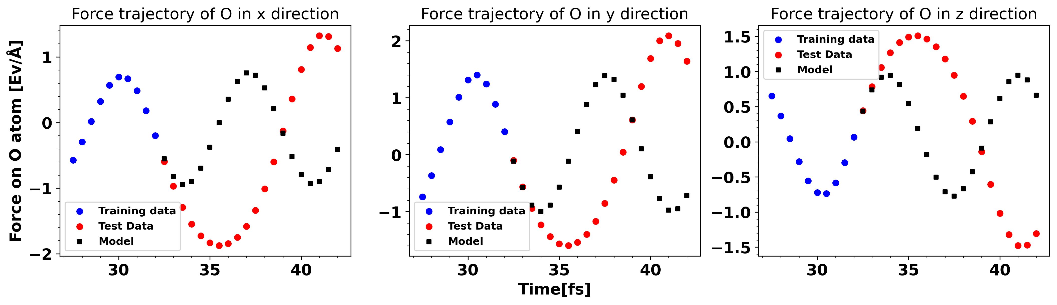
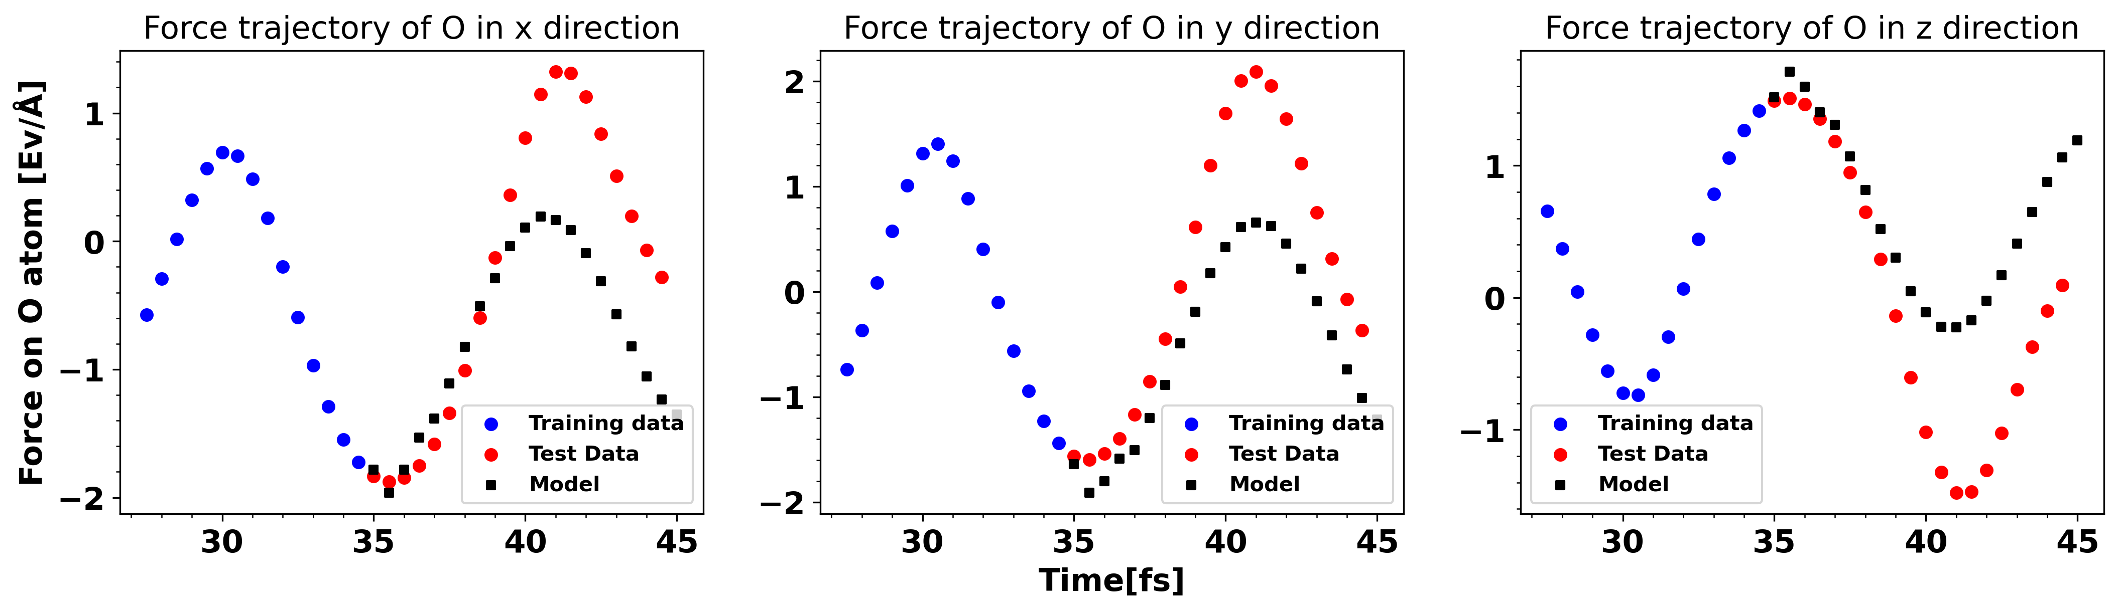
Type: AR
Input: 10
Pred: 20
Time: ~0.8s
Shift: 55
Type: VAR on O
Input: 15
Pred: 20
Time: ~2.8s
Shift: 55

Slide 4
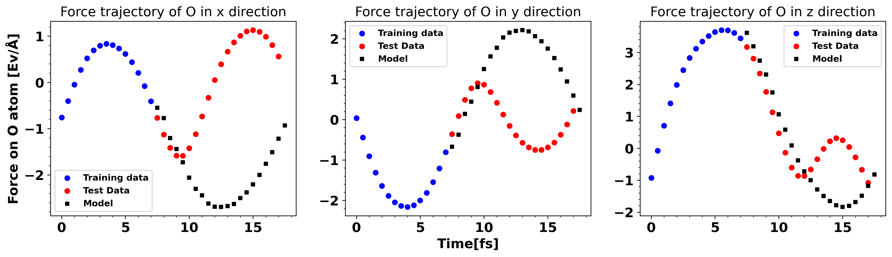

Slide 5
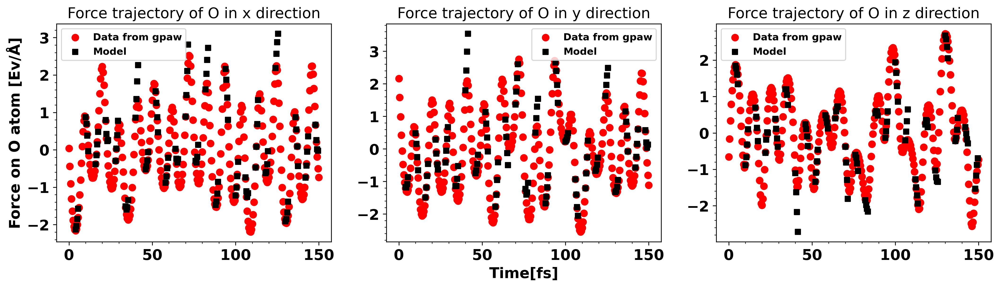
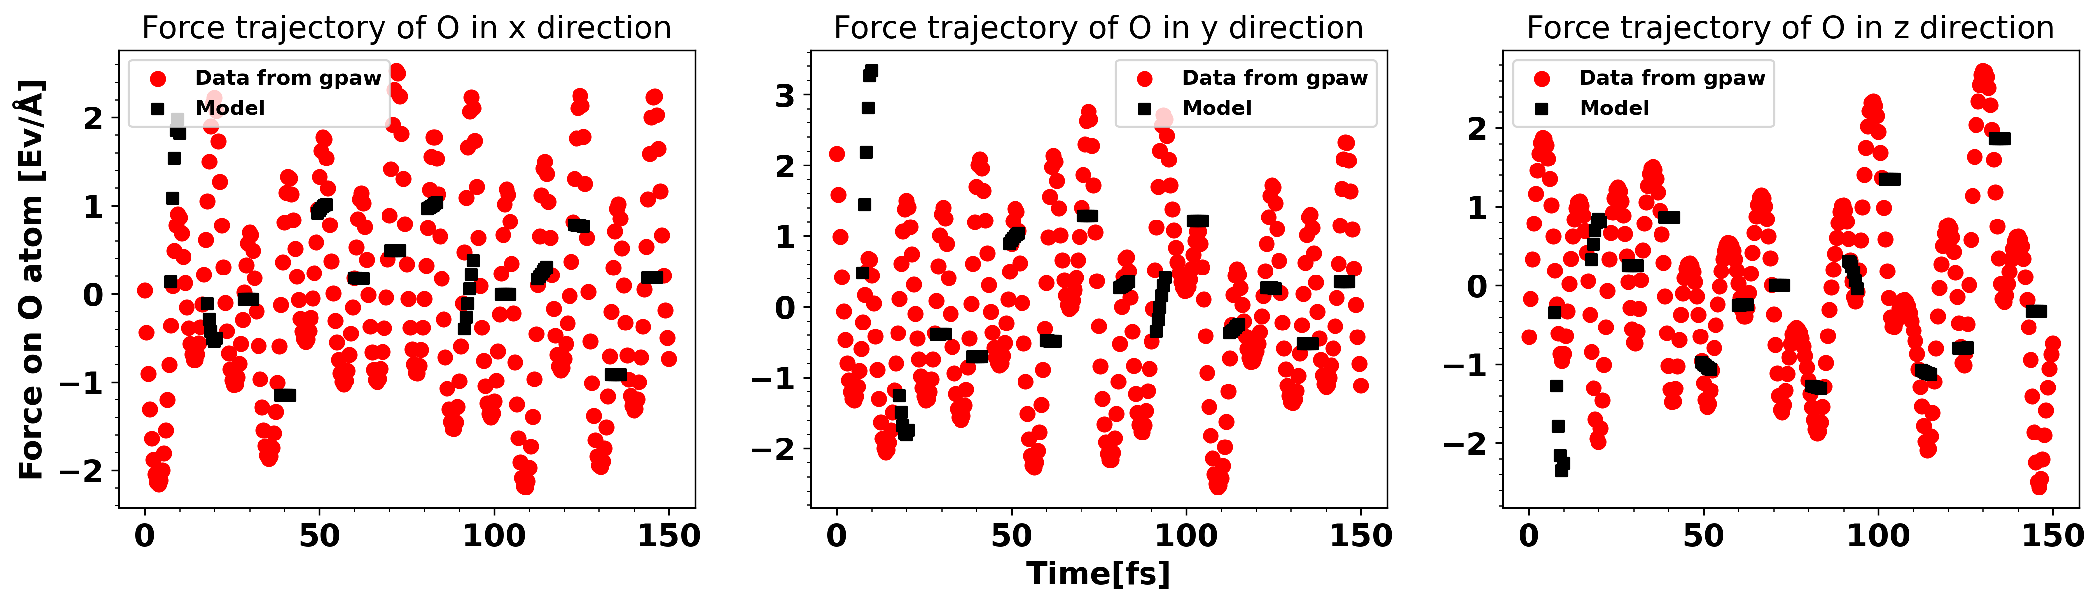
Type: AR
Input: 8
Pred: 4
MAE: 0.2
Type: VAR on O
Input: 15
Pred: 6
MAE: 0.95

Slide 6
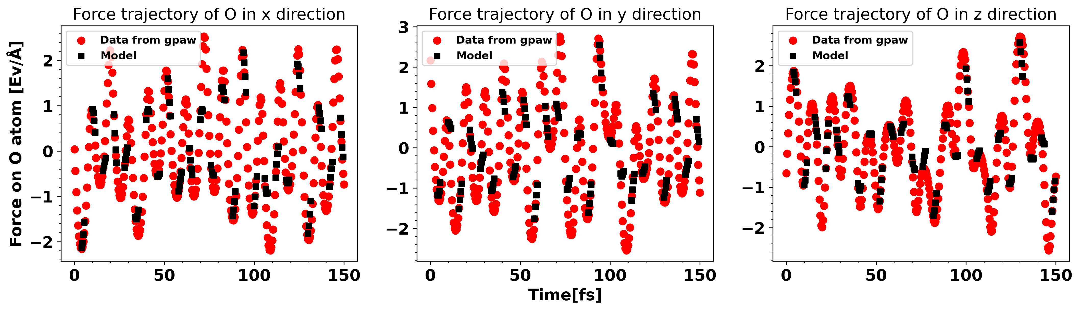
Type: AR
Input: 8
Pred: 4
MAE: 0.2
Type: AR
Input: rolling
Pred: 4
MAE: 0.23

Slide 7
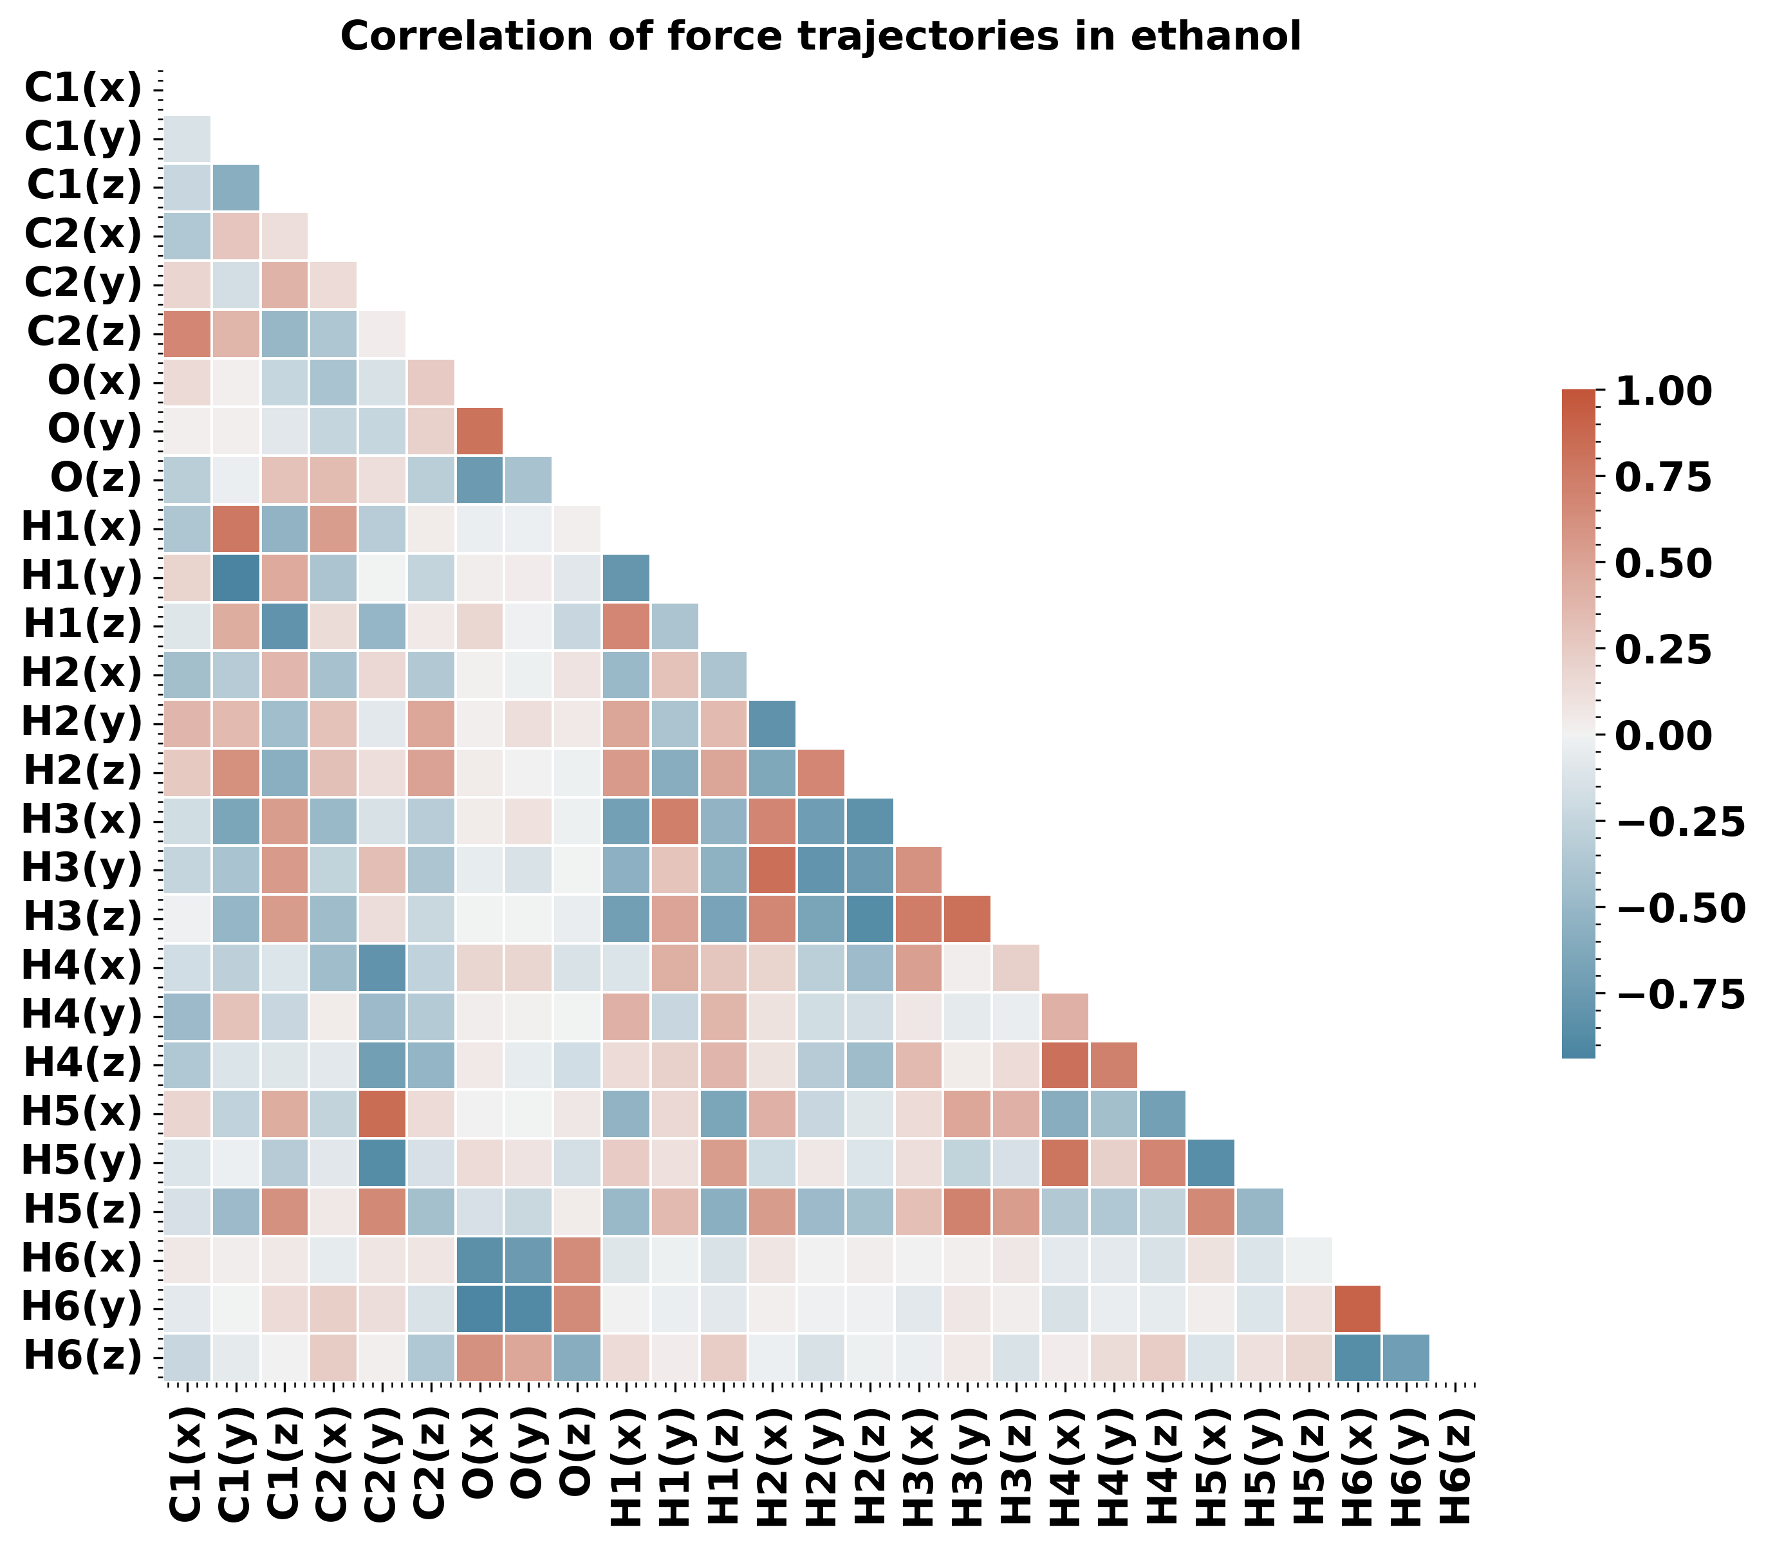
Correlation

Slide 8
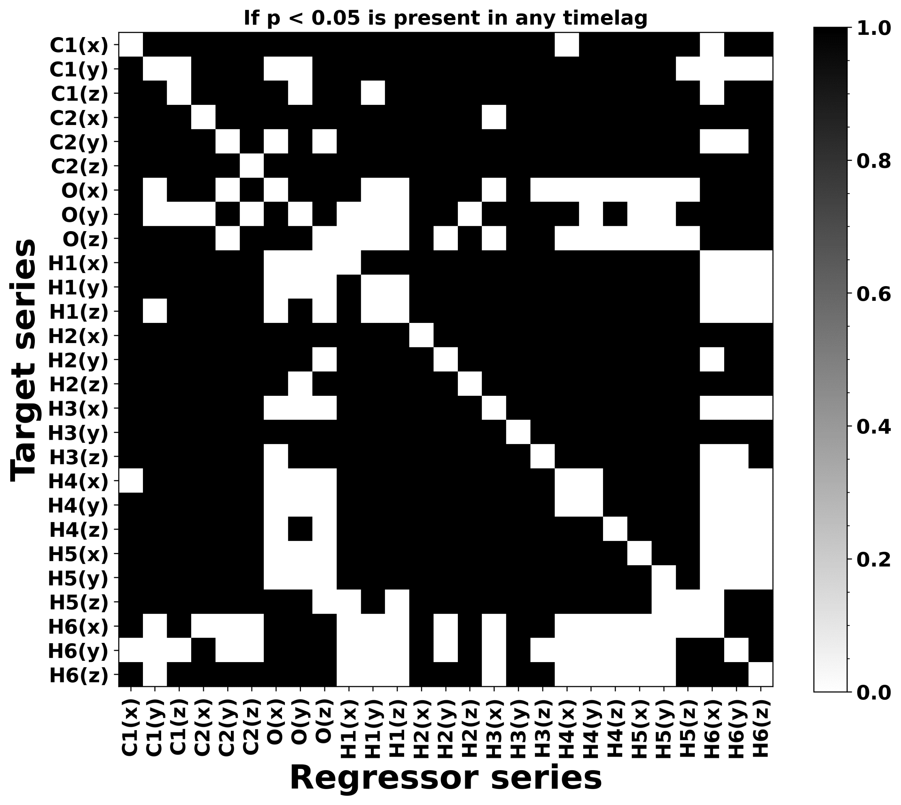
Granger causality

Slide 9
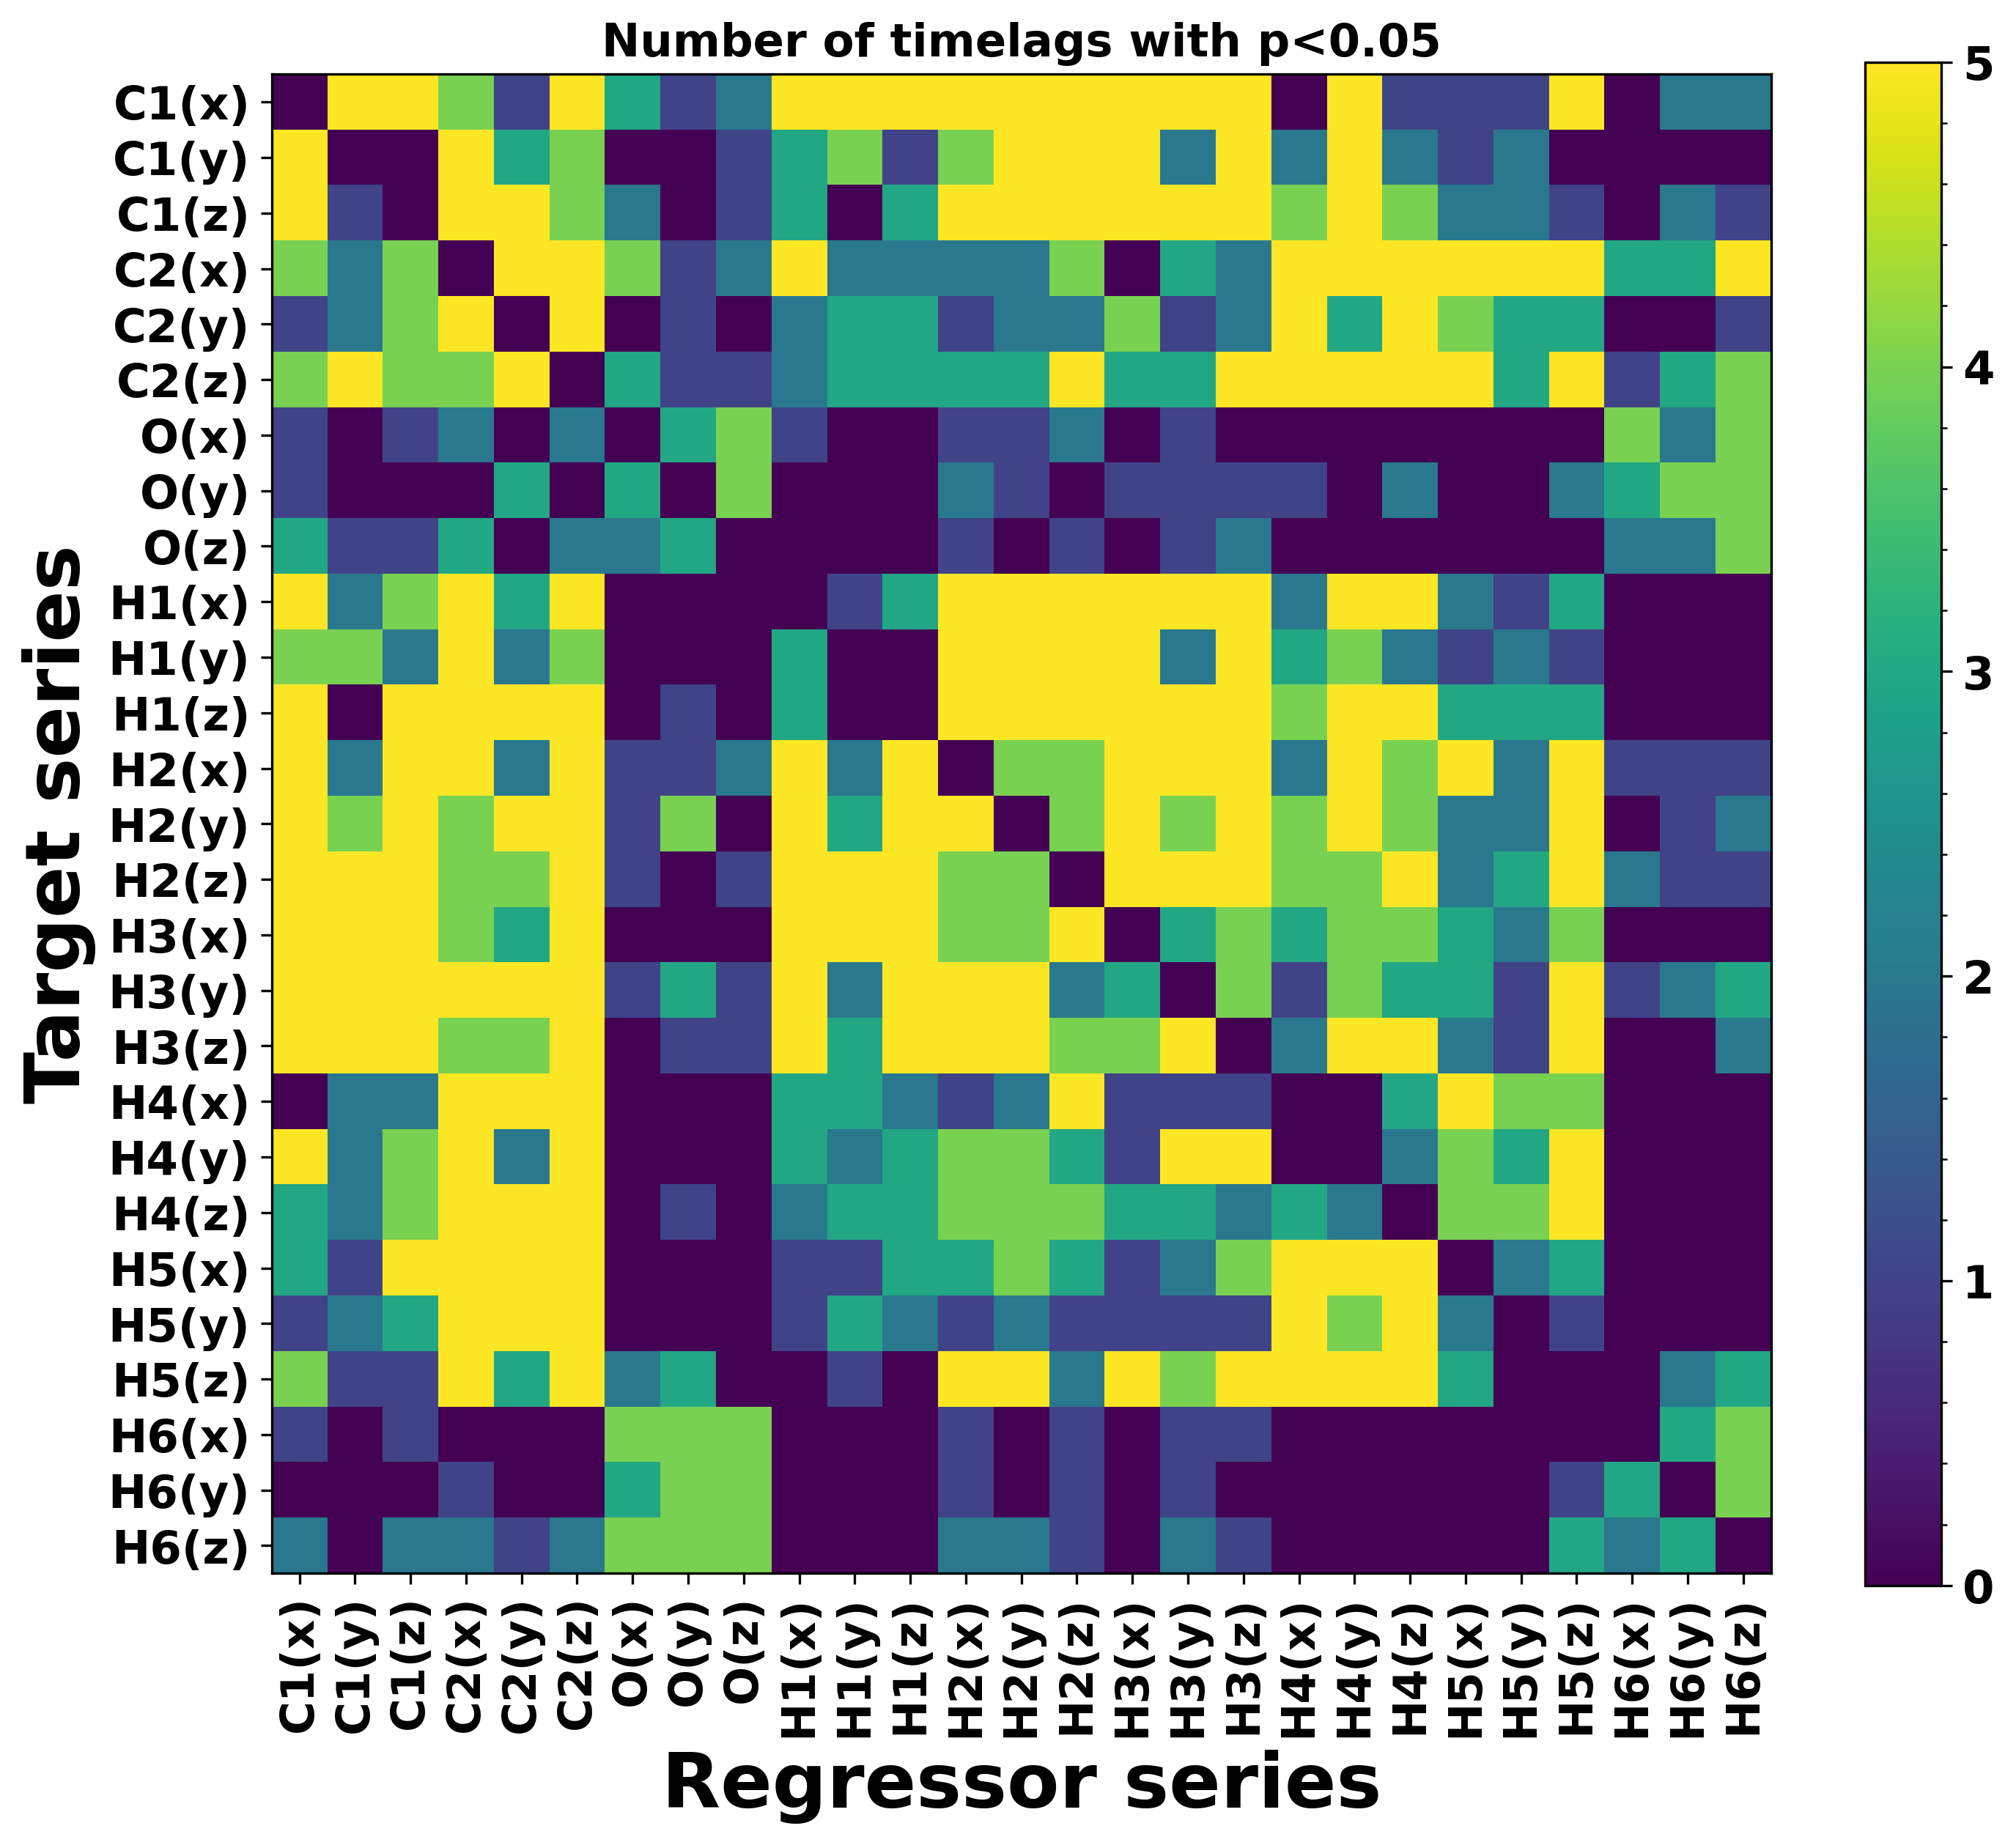
Granger causality

Slide 10
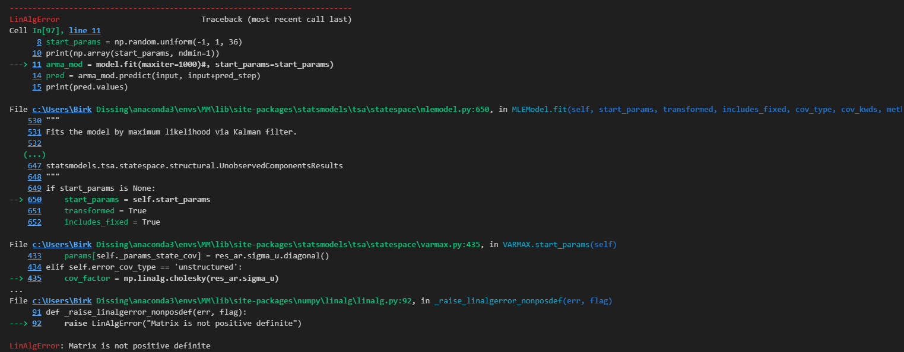
Problems with VAR
With no starting parameters. The model tries to determine good starting parameters but often runs into the following error either when input is low or number of time series high.

Slide 11
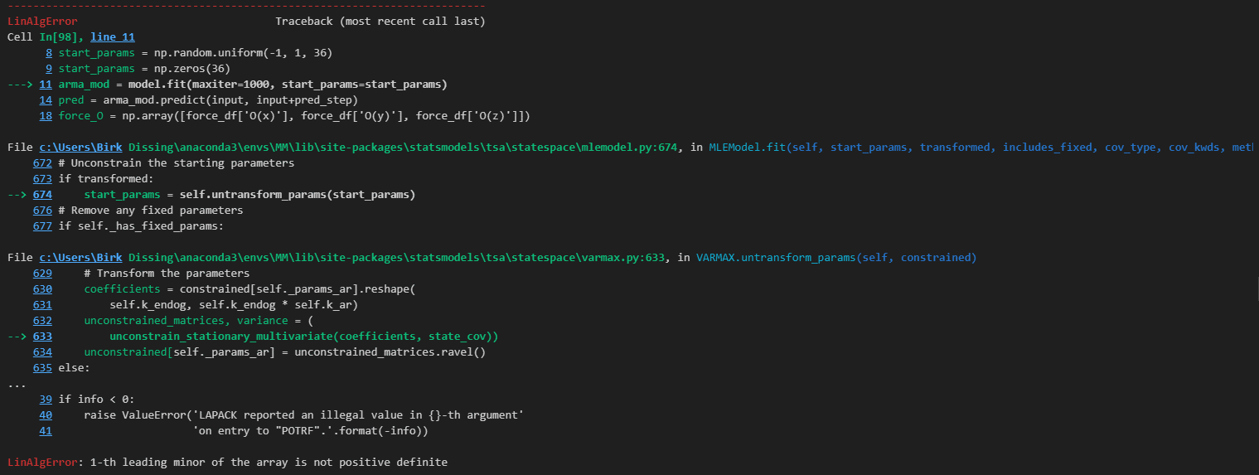
Problems with VAR
When all starting parameters are chosen to be the same. (Tested with all parameters being 0, 0.5, and 1)

Slide 12
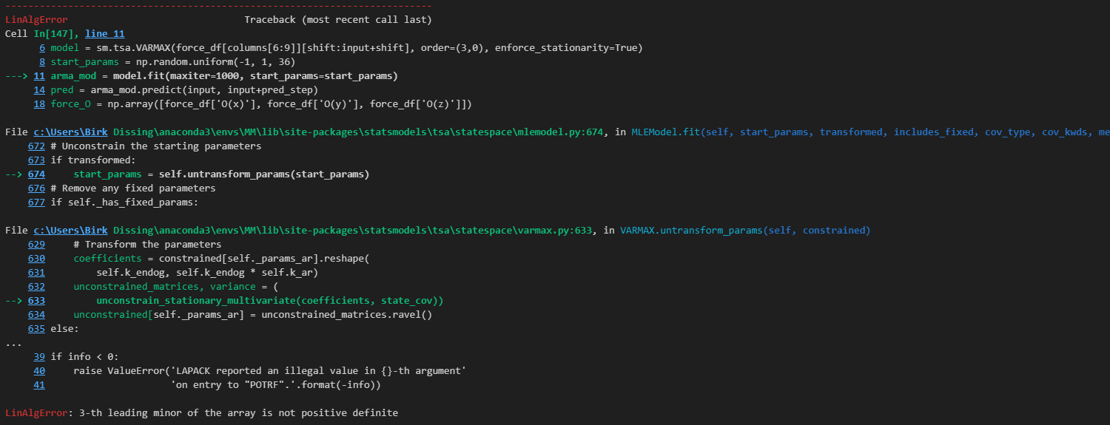
Problems with VAR
When all starting parameters are randomly chosen using a uniform distribution between -1 and 1 the same error occurs at up to 3-th leading minor. Although most often occurring at 1th or 2th leading minor.

Slide 13
